Slide 1
DIGITAL ELECTRONICS
BCD, EXCESS 3, GRAY, ASCII CODES

Slide 2
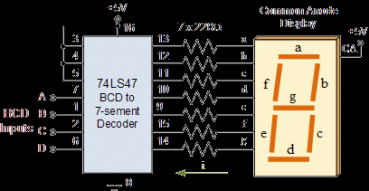
In the coding, when numbers, letters or words are represented by a specific group of symbols, it is said that the number, letter or word is being encoded. The group of symbols is called as a code. The digital data is represented, stored and transmitted as group of binary bits. This group is also called as binary code. The binary code is represented by the number as well as alphanumeric letter.

Slide 3
Advantages of Binary Code
Following is the list of advantages that binary code offers.
Binary codes are suitable for the computer applications.
Binary codes are suitable for the digital communications.
Binary codes make the analysis and designing of digital circuits if we use the binary codes.
Since only 0 & 1 are being used, implementation becomes easy.

Slide 4
Classification of binary codes
The codes are broadly categorized into following four categories.
Weighted Codes
Non-Weighted Codes
Binary Coded Decimal Code
Alphanumeric Codes
Error Detecting Codes
Error Correcting Codes

Slide 5
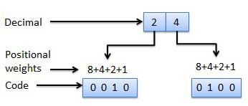
Weighted Codes
Weighted binary codes are those binary codes which obey the positional weight principle. Each position of the number represents a specific weight. Several systems of the codes are used to express the decimal digits 0 through 9. In these codes each decimal digit is represented by a group of four bits.

Slide 6
Non-Weighted Codes
In this type of binary codes, the positional weights are not assigned. The examples of non-weighted codes are
Excess-3 code and
Gray code.

Slide 7

Excess-3 code
The Excess-3 code is also called as XS-3 code.
It is non-weighted code used to express decimal numbers.
The Excess-3 code words are derived from the 8421 BCD code words adding (0011)₂ or (3)10 to each code word in 8421.
The excess-3 codes are obtained as follows −

Slide 8
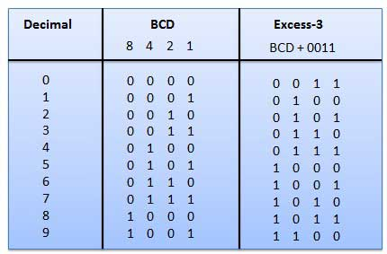

Slide 9
Gray Code
It is the non-weighted code and it is not arithmetic codes. That means there are no specific weights assigned to the bit position.
It has a very special feature that, only one bit will change each time the decimal number is incremented as shown in fig.
As only one bit changes at a time, the gray code is called as a unit distance code. The gray code is a cyclic code. Gray code cannot be used for arithmetic operation.

Slide 10
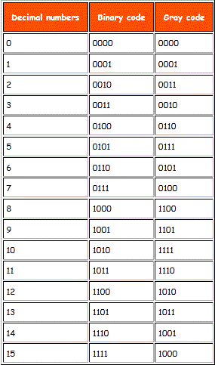

Slide 11
Gray to binary coversion
To convert a given number in Gray code into equivalent binary, the following rules are applied.
The MSB of the Binary is the same as the MSB of the Gray
Coding from left to right, add the binary digit generated to the adjacent Gray bit to get the next bit of the binary. Omit the carries if occurs

Slide 12
Example
Convert the Gray code 1110 to it binary.
Step 1
1 1 0 Gray
1 Binary
Step 2
1 1 0 Gray
1 0 Binary
Step 3
1 1 0 Gray
1 0 1 Binary
Step 4
1 1 0 Gray
1 0 1 1 Binary

Slide 13
Alphanumeric codes
A binary digit or bit can represent only two symbols as it has only two states '0' or '1'. But this is not enough for communication between two computers because there we need many more symbols for communication. These symbols are required to represent 26 alphabets with capital and small letters, numbers from 0 to 9, punctuation marks and other symbols.
The alphanumeric codes are the codes that represent numbers and alphabetic characters. Mostly such codes also represent other characters such as symbol and various instructions necessary for conveying information.
An alphanumeric code should at least represent 10 digits and 26 letters of alphabet i.e. total 36 items. The following three alphanumeric codes are very commonly used for the data representation.
American Standard Code for Information Interchange (ASCII).
Extended Binary Coded Decimal Interchange Code (EBCDIC).
Five bit Baudot Code.

Slide 14
ASCII | DECIMAL | HEX | 7-BINARY
0 | 48 | 30 | 011 0000
1 | 49 | 31 | 011 0001
2 | 50 | 32 | 011 0010
A | 65 | 41 | 100 1111
? | 63 | 3F | 011 1111

